Slide 1


BANK LOAN OF CUSTOMERS
P425-GROUP 1:
1.P.Ujwala rani
2.Nikhil Prakash bangar
3.Shubham laxman shinde

Slide 2
OVERVIEW:
Introduction
KPI 1- Year wise loan amount Stats
KPI 2-Grade and sub grade wise revol-bal
KPI 3-Total Payment for Verified Status Vs Total Payment for Non-Verified Status
KPI 4-State wise and last-credit-pull-d wise loan status
KPI 5-Home ownership Vs last payment date stats
Excel Dashboard
Power Bi Dashboard
Tableau Dashboard
SQL
Challenges Faced
Conclusion

Slide 3
Introduction:
Banks play a pivotal role in the economy by facilitating financial transactions, providing loans, managing deposits, and offering various financial services. They serve as intermediaries between savers and borrowers, promoting economic growth and stability. This introduction sets the stage for exploring the intricate workings, challenges, and significance of banks in modern society.
Analyzing banks involves assessing financial stability, performance, risk management, and market positioning. It's crucial for investors, regulators, and policymakers to gauge resilience, profitability, and systemic impact. Through comprehensive evaluations, we can understand operational efficiency, capital adequacy, and adherence to regulatory standards, vital for informed decision-making in the financial landscape.

Slide 4
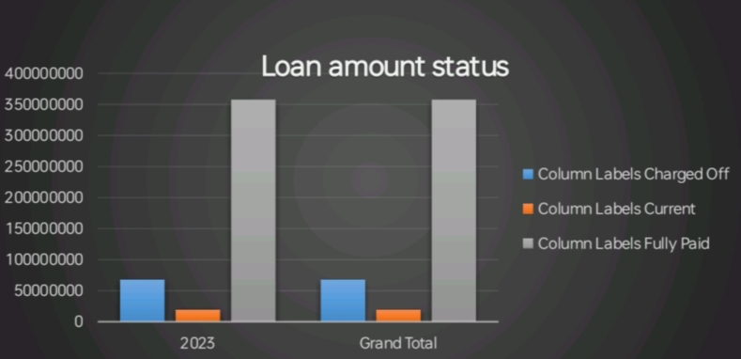
KPI 1- Year wise loan amount Stats :
Loan amounts have generally increased over the years, indicating growing borrowing activity.
Variations in loan amounts across years could be influenced by economic conditions, regulatory changes, and market demand.

Slide 5
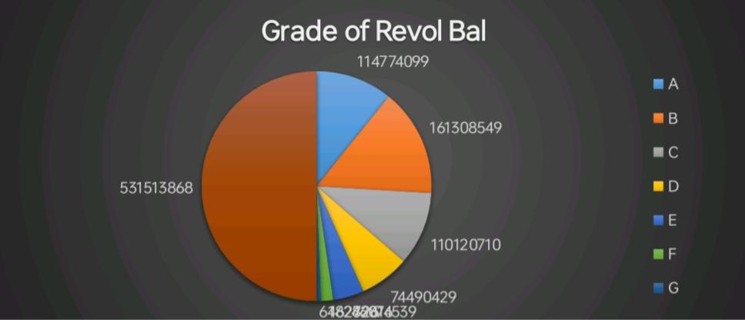
KPI 2- Grade and Subgrade-wise Revol-Bal:
Higher-grade borrowers tend to have lower revolving balances, indicating responsible credit utilization and potentially lower default risk.
Subgrade analysis reveals nuances within grades, highlighting differences in creditworthiness and financial behavior among borrowers.

Slide 6
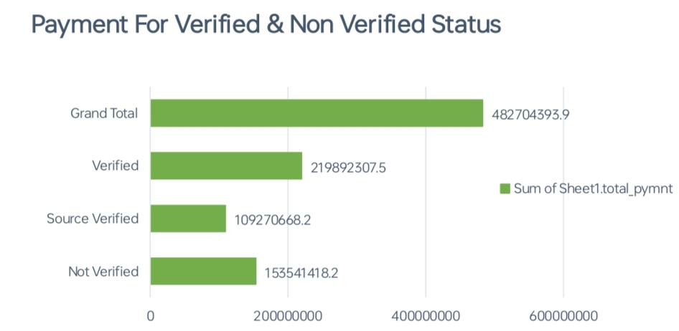
KPI 3- Total payment for verified status VS payment for Non-verified status :
Borrowers with verified income and employment status demonstrate higher total payments, suggesting a correlation between verification status and repayment behavior.
Non-verified borrowers may present higher credit risk, leading to lower payment amounts and potentially higher default rates.

Slide 7
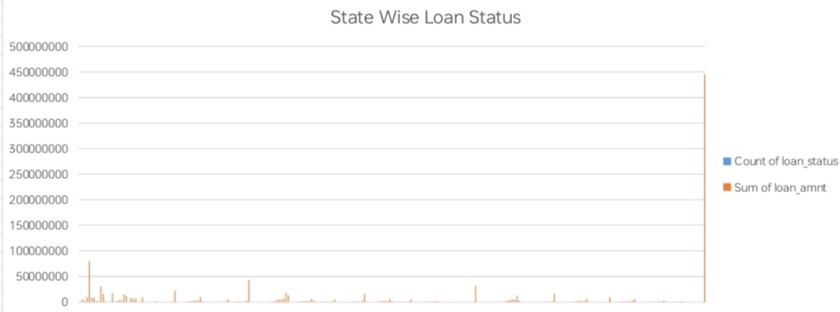
KPI 4- State wise and last credit pull date wise loan amount Stats :
Loan performance varies across states, reflecting regional economic conditions, regulatory environments, and demographic factors.
Changes in loan status based on the timing of the last credit pull could indicate the impact of credit assessment on borrower risk profiles and repayment behavior.

Slide 8
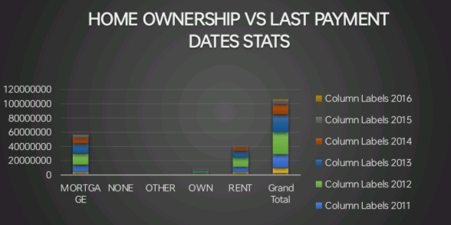
KPI 5- Home Ownership Vs last payment date Stats :
Borrowers who own homes tend to have more stable payment behavior, as evidenced by more recent last payment dates.
Renters or individuals with other housing arrangements may exhibit more varied payment patterns, influenced by factors such as rental affordability and housing instability.

Slide 9
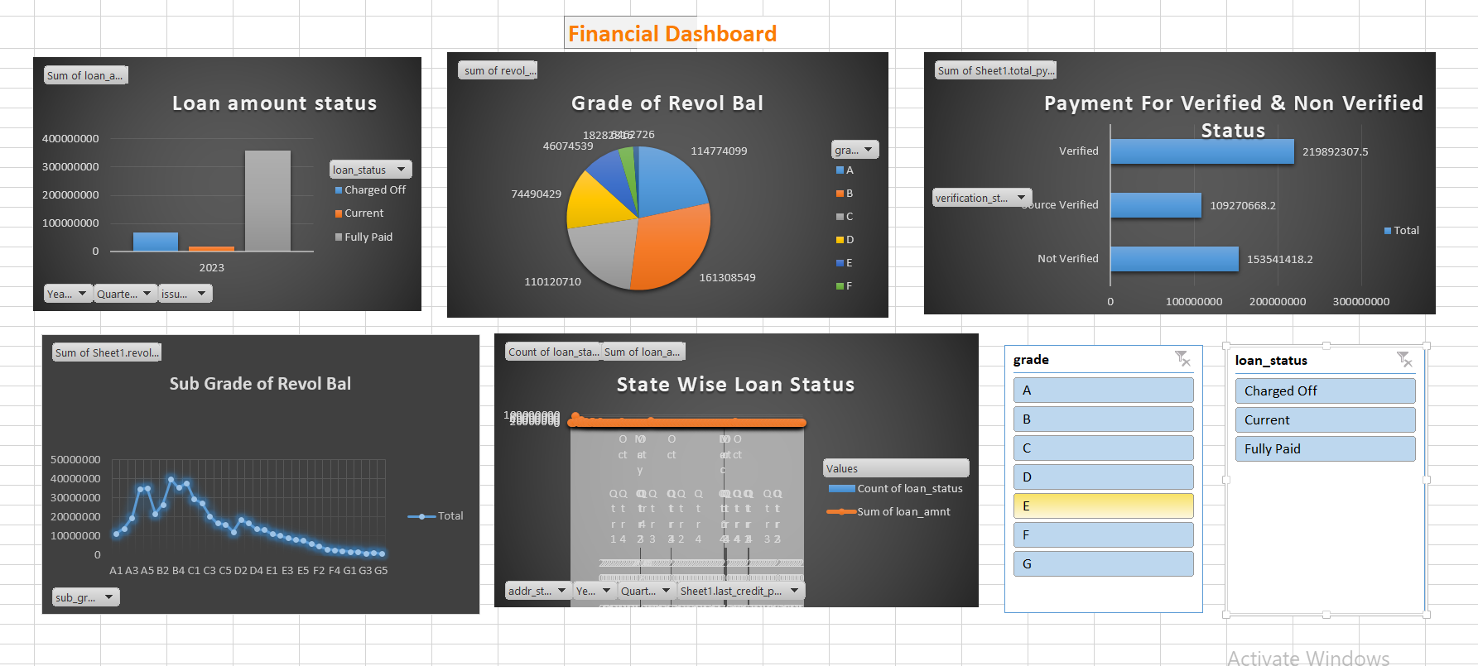
Excel Dashboard

Slide 10
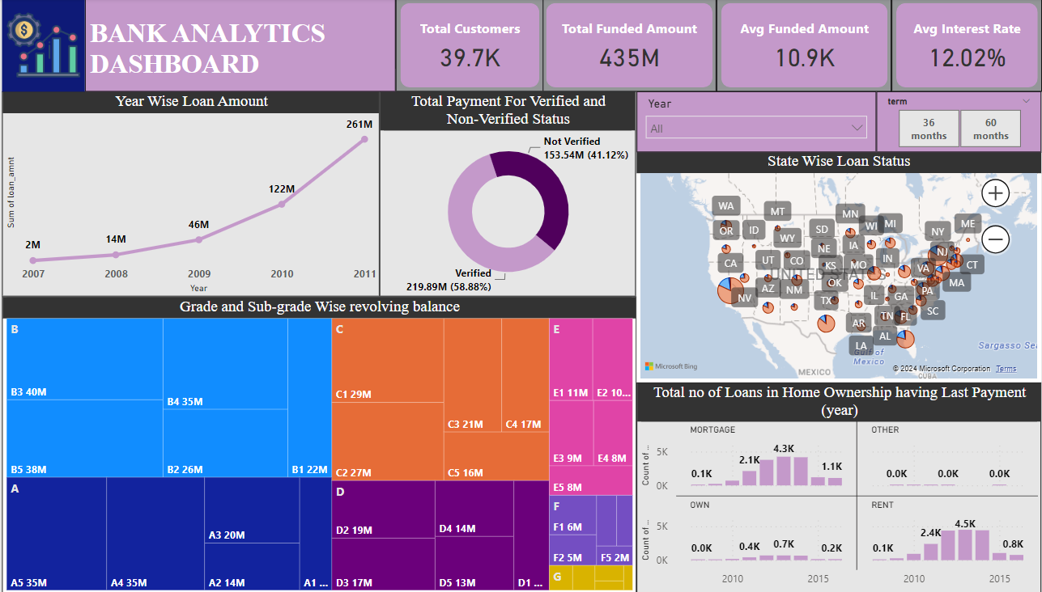
POWERBI DASHBOARD

Slide 11
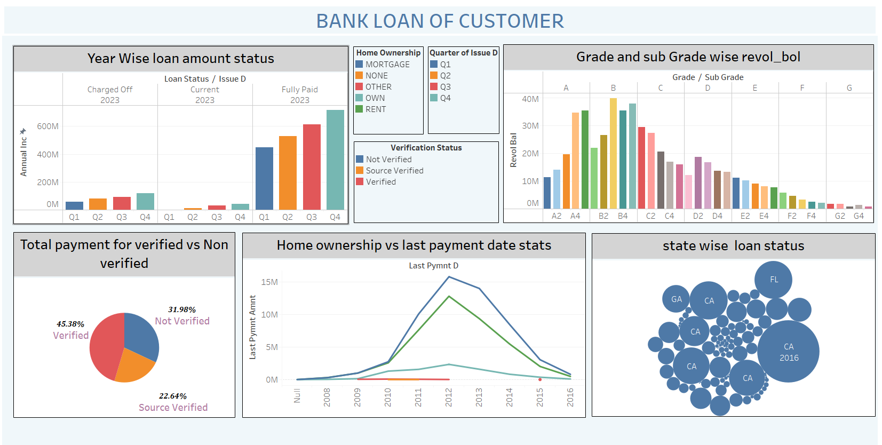
TABLEAU DASHBOARD

Slide 12
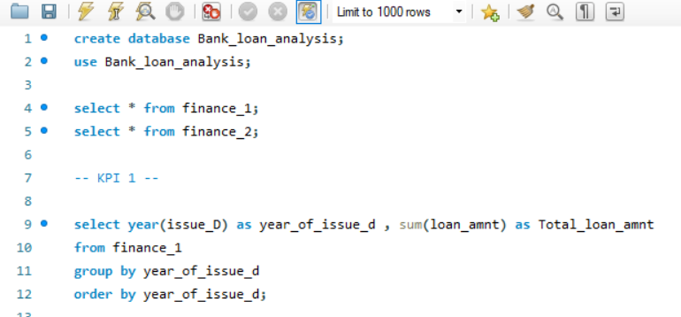
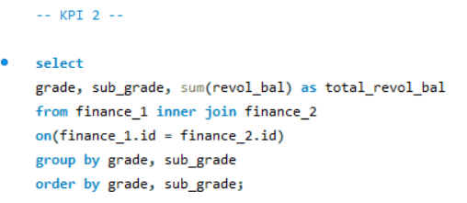
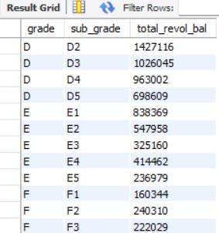
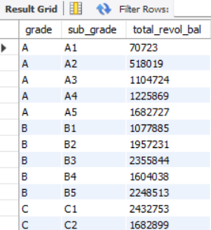

SQL
Output :
Output :

Slide 13
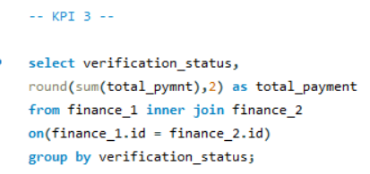
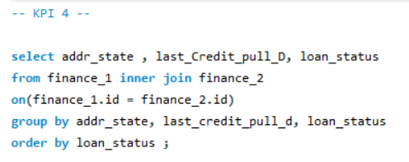
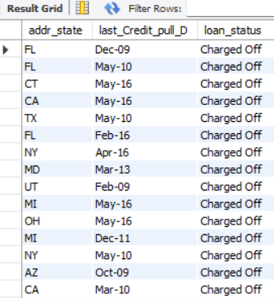

SQL
Output :
Output :

Slide 14
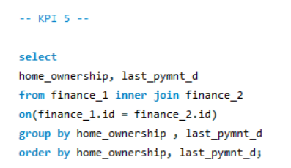
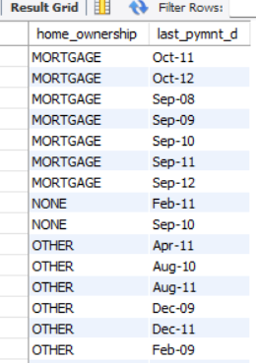
SQL
Output :

Slide 15
Challenges faced:
While analyzing the provided data on loan performance and borrower behavior, several challenges may arise:

Slide 16
Outcome of the project:
:
The implementation of KPIs in Excel, Tableau and Power BI helped to gain proficiency with the application of these business analytics tools.
The group project taught us how to collaborate and work as a team to produce the output more effectively.
The weekly check points helped to plan the project in a better way which allowed to achieve the larger objectives.

